Slide 1


Katthe Technologies: Empowering Local Communities
Katthe Technologies is a forward-thinking company dedicated to developing innovative solutions that enhance the lives of local communities. With a focus on transparency, efficiency, and social awareness, Katthe is revolutionizing the way people interact with their local environments.

Slide 2

A Focused Approach
1
Transparent & Corrective Systems
2
Proper Utilization of Resources
Leveraging technology to create systems that are open, accountable, and responsive to community needs.
Ensuring that existing resources are used effectively and efficiently to benefit the community.
3
Direct Contribution to the Needy
Connecting those in need with resources and opportunities through innovative platforms.

Slide 3
Our Innovative Projects
SmartTown.in
Hennu.in
UnWell.in
A centralized, town-based platform that enables easy, self-controllable access to local businesses, services, and community information.
A dedicated platform focused on girl and women's safety and empowerment, leveraging technology to create a safer environment.
Making health and medicines more affordable and accessible for everyone, with a non-commercial approach.

Slide 4

Our Office & Team
Our registered office is located in the vibrant city of Bhadravathi, Karnataka, India.
Mostly all remotely connected, based on need will make more offices across the globe.
Madhusudhan V
Architect, with extensive experience in international key projects and a passion for community-driven solutions.
Global Contributors
Namitha K
Manjushree V Veerabhadrappa R … more adding Gradually
We connect with a network of global contributors and freelancers to bring diverse perspectives and expertise to our projects.
Non-Technical Contributions
We welcome contributions from a wide range of individuals, including housewives, handicaps, retired experts, students, and government employees.

Slide 5





Powering Our Solutions
Web Technologies
Microsoft Technologies
Open-Source Contribution
Artificial Intelligence
Leveraging web technologies to ensure easy connectivity and offline support.
Utilizing Microsoft's robust ecosystem, with support from Google and Amazon.
Actively researching and contributing to open-source projects to meet client requirements.
Expanding our capabilities with the integration of cutting-edge AI solutions.

Slide 6

Introducing SmartTown: Connecting Your Local Community
SmartTown is a centralized, town-specific platform that puts the power of information and connectivity right in the hands of residents and local businesses. Discover what's happening, get the details you need, and stay informed about your community.
by Katthe Technologies, India

Slide 7
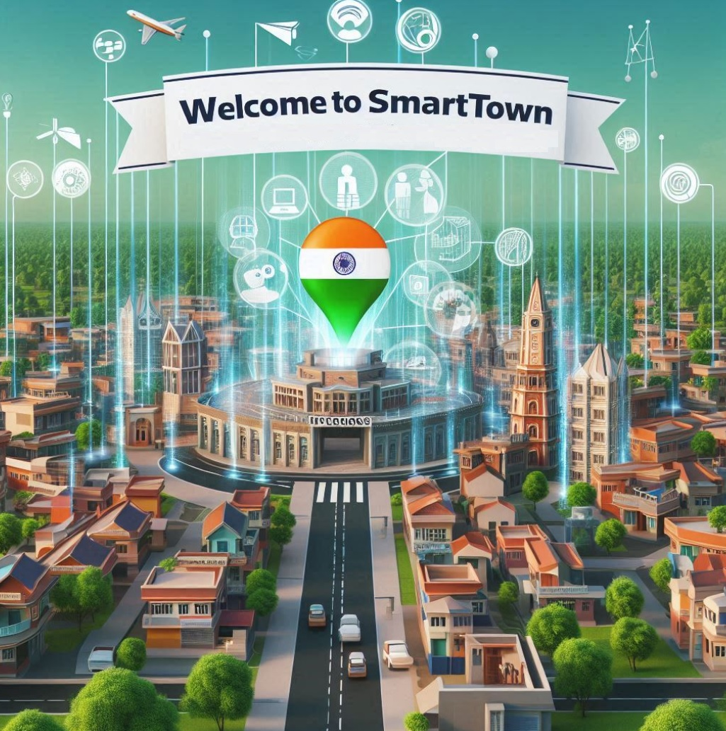

Slide 8

Addressing the Information Gap
1
Missing Information
2
Lack of Connectivity
Residents often struggle to find reliable, up-to-date information about local businesses, services, and events.
Small businesses have limited options to effectively reach and connect with their local customer base.
3
Decentralized Data
Information is scattered across multiple platforms, making it difficult for both residents and businesses to access.

Slide 9
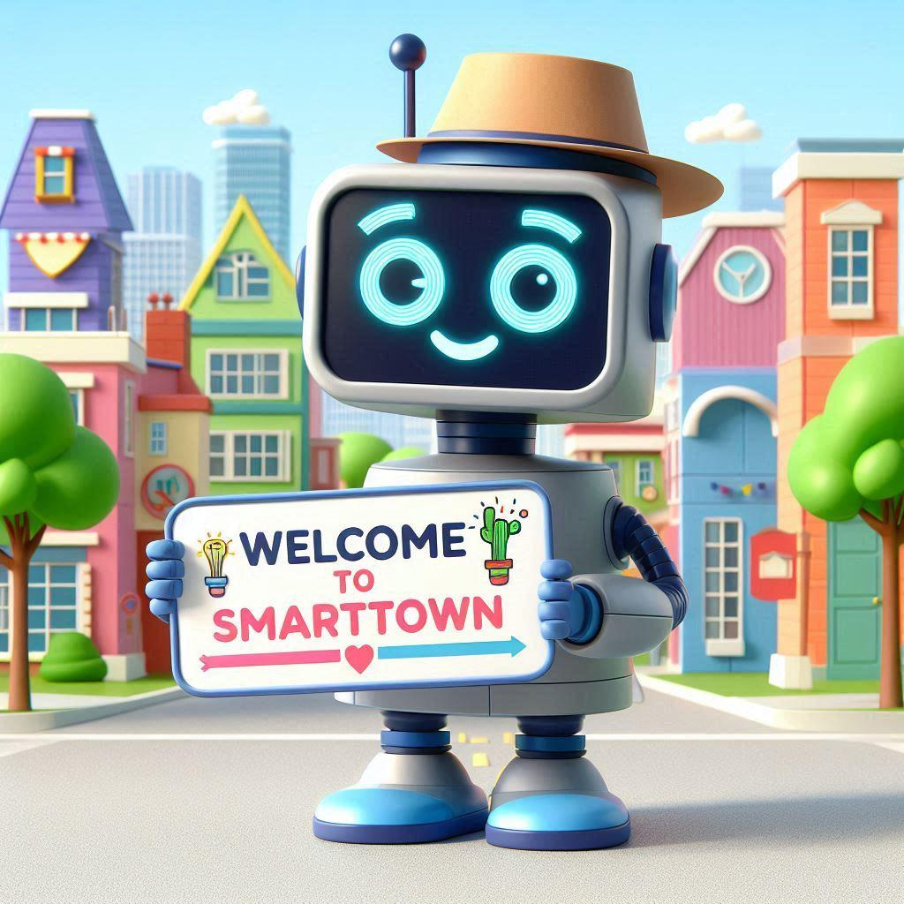
SmartTown: Your Town's Digital Hub
Centralized Data
Empowering Businesses
Informed Residents
SmartTown aggregates and organizes all the essential information about your town in one user-friendly platform.
Local businesses can easily create and manage their online profiles, share updates, and connect with customers.
Residents can access real-time information about businesses, events, and community news with just a few taps.

Slide 10
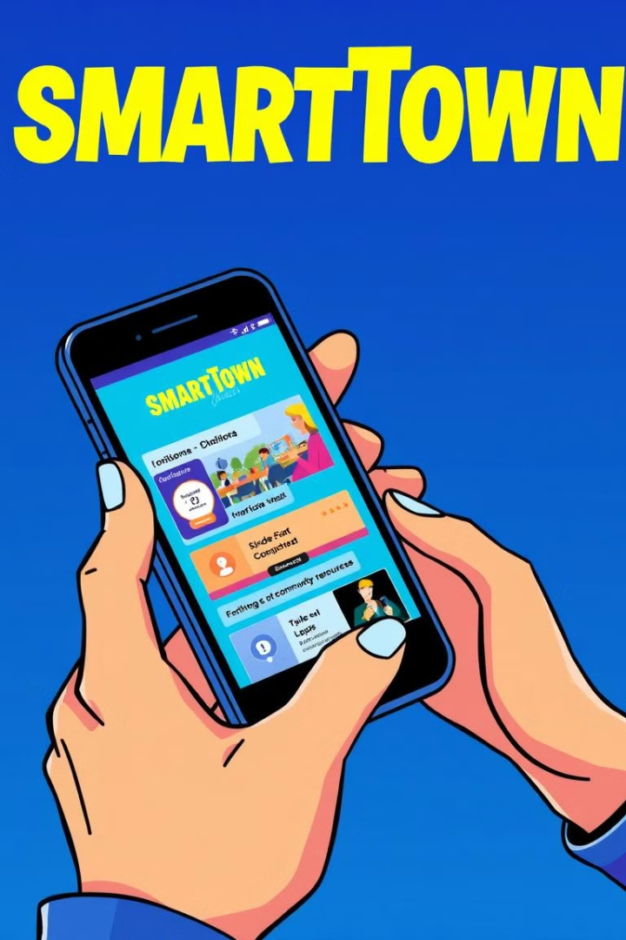
Simplifying Local Interactions
Easy Access
Transparent Pricing
User-friendly and accessible, with a mobile-friendly interface and offline capabilities.
Flexible and affordable advertising options for local businesses, with no hidden fees or commissions.
Peer Validation
Customizable Profiles
Business listings are verified by the community, ensuring accurate and reliable information for users.
Businesses can easily update their profiles, menus, and offerings, keeping their information current and engaging.

Slide 11





Connecting Businesses and Customers
Business Profiles
Events & Promotions
Customer Reviews
Direct Communication
Businesses can create detailed profiles to showcase their offerings, hours, and contact information.
Businesses can easily share their upcoming events, sales, and special offers with the local community.
Customers can leave reviews and ratings to help others make informed decisions about local businesses.
Customers can directly contact businesses through the platform, fostering better customer-business relationships.

Slide 12

Empowering Local Economies
1
Increased Visibility
SmartTown helps local businesses reach a wider audience and gain more visibility within their community.
2
Fostering Connections
The platform facilitates connections between businesses and customers, leading to more engaged local communities.
3
Supporting Growth
By providing affordable and effective marketing tools, SmartTown enables small businesses to thrive and expand.

Slide 13
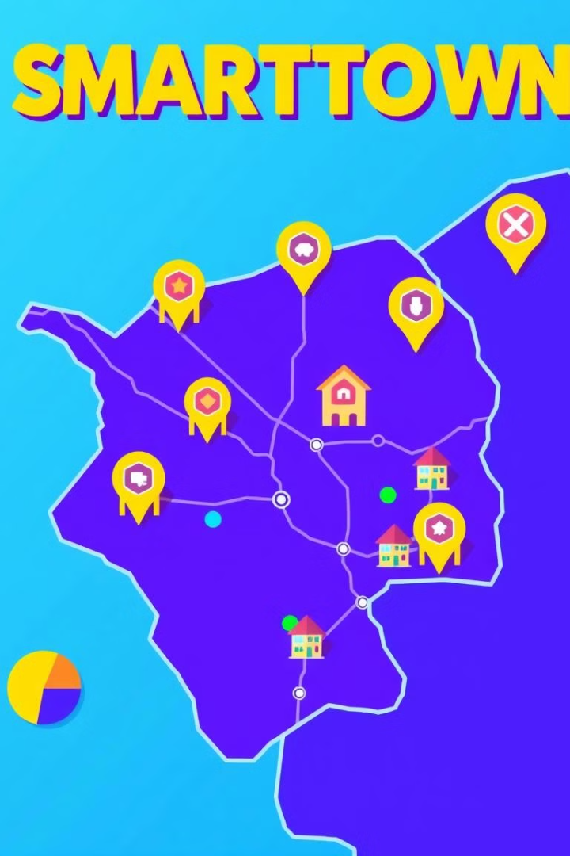



Expanding Reach, One Town at a Time
Scalable Model
SmartTown's modular design allows for easy replication and deployment in new towns, creating a network of connected communities.
Customizable Branding
Each SmartTown instance can be tailored to the unique identity and needs of the local community, ensuring a seamless user experience.
Collaborative Growth
SmartTown encourages peer-to-peer validation and community engagement, fostering a shared sense of ownership and pride.

Slide 14

Your Town, Your Voice
Resident Feedback
Streamlined Communication
Collaborative Decision-Making
SmartTown provides an easy platform for residents to share their ideas, concerns, and feedback about their town.
The platform facilitates transparent and efficient communication between local authorities, businesses, and the community.
SmartTown empowers residents to actively participate in shaping the future of their town through collaborative initiatives and decision-making processes.

Slide 15

Join the SmartTown Revolution
1
Become a Partner
2
Spread the Word
3
Stay Involved
Collaborate with us to bring the power of SmartTown to your community and help shape the future of local connectivity.
Share the vision of SmartTown with your friends, neighbors, and local businesses, and help us build a network of thriving, connected towns.
Provide feedback, suggestions, and ideas to help us continuously improve the SmartTown platform and better serve the needs of your community.

Slide 16

The Future of Local Communities
SmartTown is not just a platform – it's a vision for the future of local communities. By empowering residents and businesses with the tools they need to connect, collaborate, and thrive, we're building a network of towns that are more transparent, engaged, and prosperous than ever before.

Slide 17





Connect with Us
Email
Katthe@Outlook.in
Katthe@Katthe.com
Website
www.Katthe.com
Project: SmartTown.in
www.SmartTown.in
Phone
+91-9482696525

